Slide 1
SCRUM
The most widely used Agile development methodology

Slide 2
Scrum methodology is widely used across portfolios, programs, and/or projects in any industry, products, services, or any other deliverables to be developed and projects of any size or complexity. SCRUMstudy.com

Slide 3
Overview of Scrum
A Scrum project involves a collaborative effort to create a new product or other result defined in the Project Vision Statement.
All projects are impacted by Time, Cost, Scope, Quality, Resources, Organizational Capabilities, and other Limitations
Successful implementation results in significant business value to the organization.
This is why a project management process like Scrum is needed

Slide 4
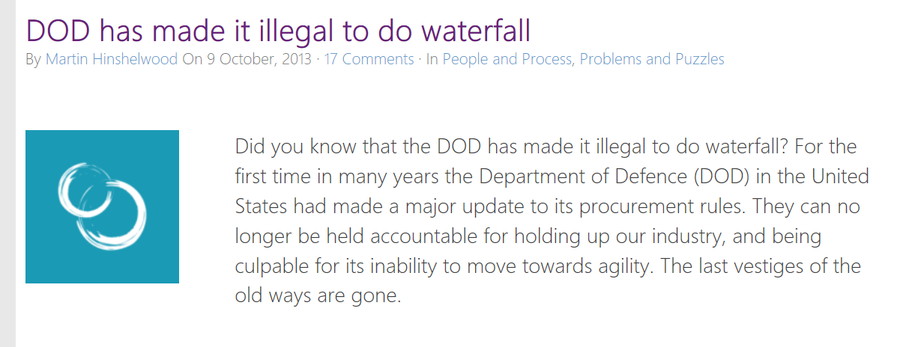

Slide 5
What is Scrum
Popular Agile Methodology
Adaptive, iterative, fast, flexible, and effective
Ensures transparency in communication
Creates collective accountability and continuous progress
Supports all kinds of projects – Supports product and service development in all types of industries and any type of product, regardless of its complexity.

Slide 6
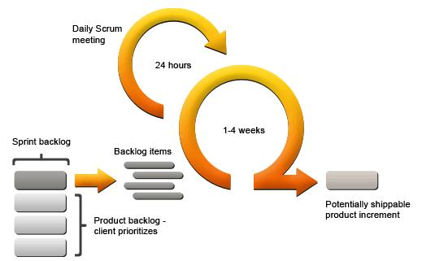

Slide 7
History of Scrum
Developed in the 1980’s
Holistic Rugby Approach – Passing the ball back and forth instead of a sequential process. Moving the Scrum downfield
Ken Schwaber – Presented Scrum’s applicability to the software industry at OOPSLA 1995

Slide 8
Benefits of Using Scrum
Adaptability – iterative delivery allows to embrace change
Customer centric
Continuous Delivery of Value – each sprint has a potentially shippable product
Early Delivery of High Value – highest value items first
Continuous Feedback – Through daily standup
Transparency – All artefacts are always shared with everyone. High-trust environment
Continuous Improvement – Sprint by sprint
Sustainable Pace
Efficient Development Process through Time Boxing
Faster Problem Resolution – By collocating cross-functional teams
Collective Ownership
High Velocity – Encourages Hyper-productivity

Slide 9
Scrum of Scrums Process
Scrum is also for large teams
Facilitates coordination among the Scrum teams
Enables Effective implementation in larger projects
Manage projects of any size, spanning geographies, and organizations
Can manage event programs and portfolios
Each Scrum team is represented in the Scrum of Scrums
No set rule of frequency. Held as needed.

Slide 10
Scrum Quality
Defined as the ability of the completed product or deliverables to meet the “Acceptance Criteria” and achieve the business value expected by the customer
Quality related tasks (QA/Testing) are completed as part of the same sprint
Continuous improvement with repetitive testing optimize the probability of achieving the expected quality levels.

Slide 11
Change Management in Scrum
Stakeholders may change their mind about what they want during the project (Requirements Churn)
Scrum welcomes change by using short iterative sprints with feedback on each sprint’s deliverables

Slide 12
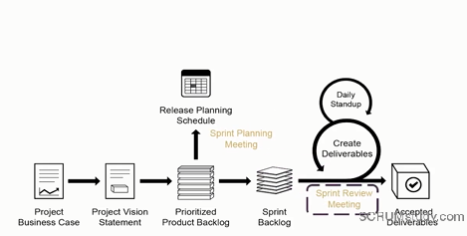

Slide 13
Product Backlog contains a prioritized list of business and project requirements, written in the form of User Stories

Slide 14
Prioritized Product Backlog
Starts from an “Epic” – Which is a large unrefined list of user stories
Epic is refined to include prioritization and cost estimation of the User Stories
Product Owner Approves the User Stories for a Sprint
Scrum Team estimates the effort needed to develop the User Story
Scrum Team commits the User Stories
Establishes the definition of “Done”

Slide 15
During Sprint Planning – High priority product user stories are considered for inclusion into the Sprint. Sprint – Usually lasts between 1 and 6 weeks with the team creating potentially shippable product deliverables.

Slide 16
Sprints are short time spans in which a certain amount of work must be done.

Slide 17
What’s a User Story?
Features/Requirements written from the perspective of the User
Who will benefit from the requirement (ie. Who is the User?)
What will the User Get?
Why is it important?
“As a PC user, I want a calculator with basic functionality on my PC so that I can conveniently perform basic mathematic operations.”

Slide 18
User Story Template “As a <type of user>, I want <some goal> so that <some reason>.”

Slide 19
Creating Tasks from User Stories
Approved, Estimated User stories are compiled into a Task List
Estimate Task List
Through a “Task Estimation” exercise, the Scrum team estimates the effort required to accomplish each item in the task list

Slide 20
Creating the Sprint Backlog
Scrum core team holds Spring Planning Meetings
Sprint Backlog contains all tasks to be completed in the sprint

Slide 21
Sprint Deliverables
Scrum Team works on the tasks in the Sprint Backlog to create Sprint Deliverables
Scrumboard is often used to track work and activities being carried out
Issues are logged in the impediments log

Slide 22
Daily Standup Meetings
Are short and very focused scrum meetings that happen every day. Team members discuss daily progress.

Slide 23
Sprint Reviews
Happens at the end of every sprint.
Project stakeholders are provided a Demonstration of the Deliverable.
Deliverables are only accepted, if they satisfy the pre-defined Acceptance Criteria.

Slide 24
What are Scrum Teams
Cross-Functional (eg. Developers, Testers, product owners, etc.)
Self Organized
Empowered
Operate in short, concentrated work cycles called “Sprints”

Slide 25
SCRUM Roles and Responsibilities
Core Roles -
Product Owner – (Can also be a Scrum team member)
Responsible for achieving maximum business value for the project
Voice of Customer Requirements and Business Justification
Owns the prioritization of Product Backlog
Scrum Team –
Responsible for understanding the requirements set by the Product Owner
Responsible for the project deliverables
Owns how much work can be done in a sprint
Scrum Master – Facilitator, Guides, and Teaches Scrum principles.

Slide 26
Scrum Non-Core Roles (optional)
Stakeholders – Customers, Users, and Sponsors
Vendors – Provide product/services that are not core-competency of team
Chief Product Owner – Coordinates the work in organizations with multiple scrum teams.
Chief Scrum Master - Coorindates

Slide 27
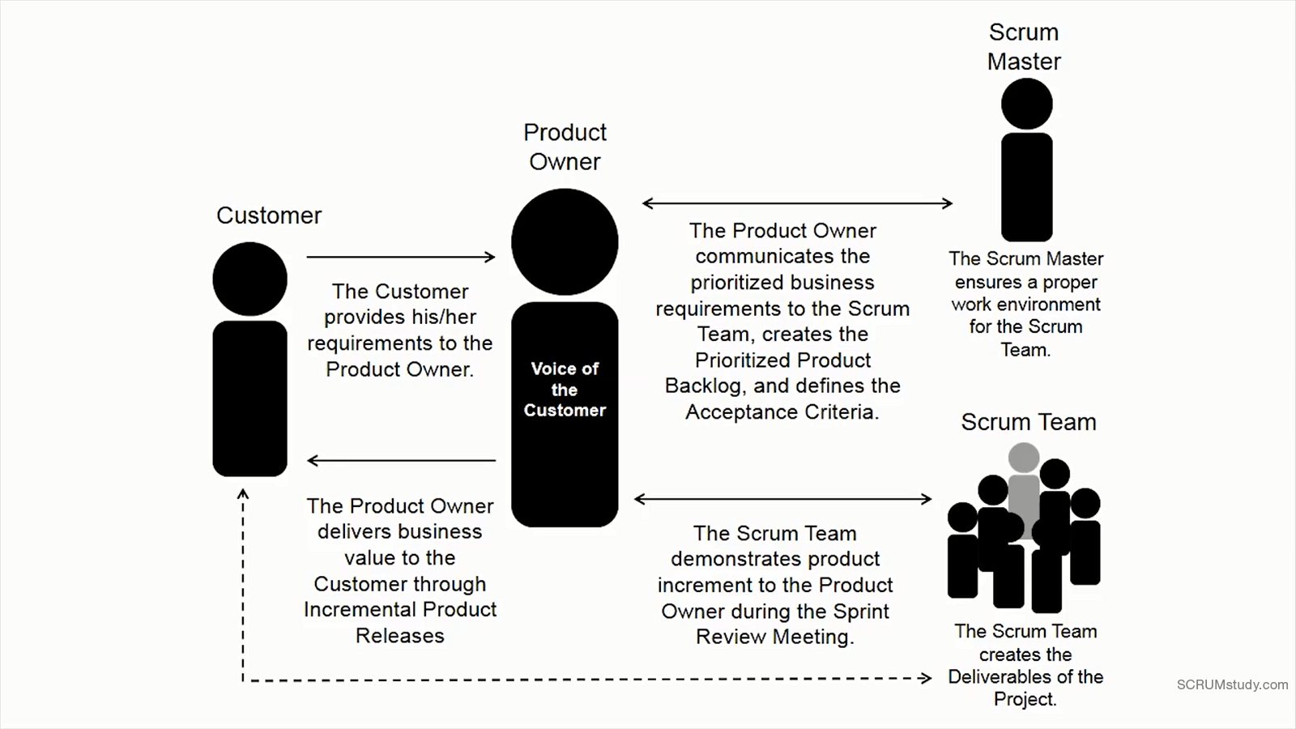
From SCRUMStudy.com

Slide 28
Adapting Scrum to PROFSWD
We only meet once a week
Teams will map to Scrum teams with the following roles:
Product Owner – Identify one team member. Can also still be a member of the Scrum team.
Scrum Team
Cross-functional. No distinction between developers and testers.
Professor will play the role of Scrum Master/Facilitator

Slide 29
Visual Studio Online
Where Scrum Artifacts will be stored and visible to everyone in the team for full transparency
Product Backlog, User Stories, Sprint Plan, Task List, Estimates etc.
Where your Source, Tests, Work Items will be stored
Where work is assigned to the team and progress is tracjed
Covers the following Phases
Work - Create and manage your product backlog in minutes
Code - Learn about working with your code
Build - Learn about builds in the cloud
Test - Learn more about test manager and test planning

Slide 30
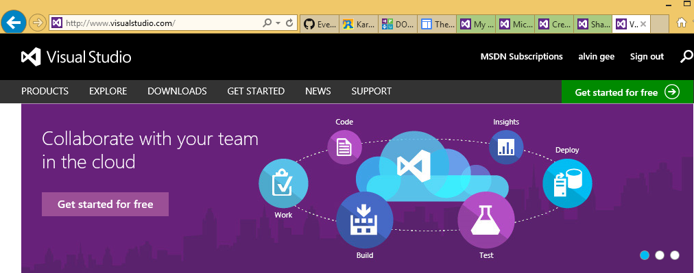
Sign Up for Visual Studio Online

Slide 31
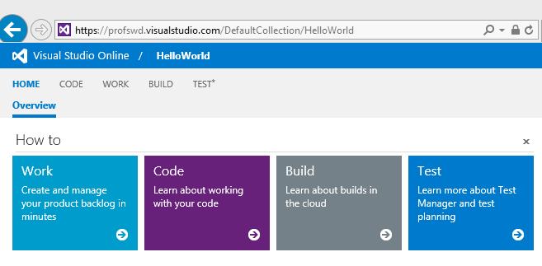
www.visualstudio.com

Slide 32
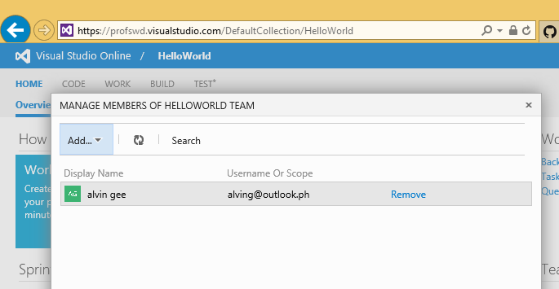
Add your Team Members to VS Online (also alving@outlook.ph)

Slide 33
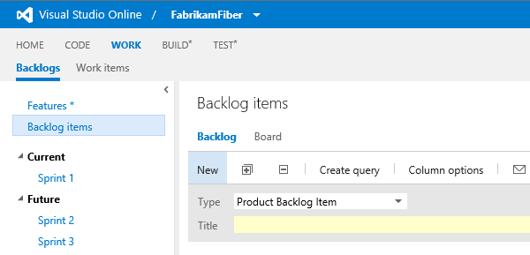
Creating your Product Backlog in VSOnline

Slide 34
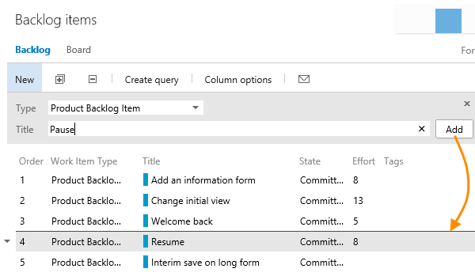

Slide 35
Project Presentations

